Slide 2
Welcome To Åssiden upper secondary school

Slide 3
Norways largest vocational school
Youth (16-19 years) 1600 students
Adults: about 500 students
320 employees
8 houses Large campus

Slide 4
Key question:
«What is a good student?»

Slide 5
Working with values
School vision
Pedagogical manifest
Commitment and ethical responsibity
School leadership

Slide 6
Educational programmes:
8 vocational programmes

Slide 7
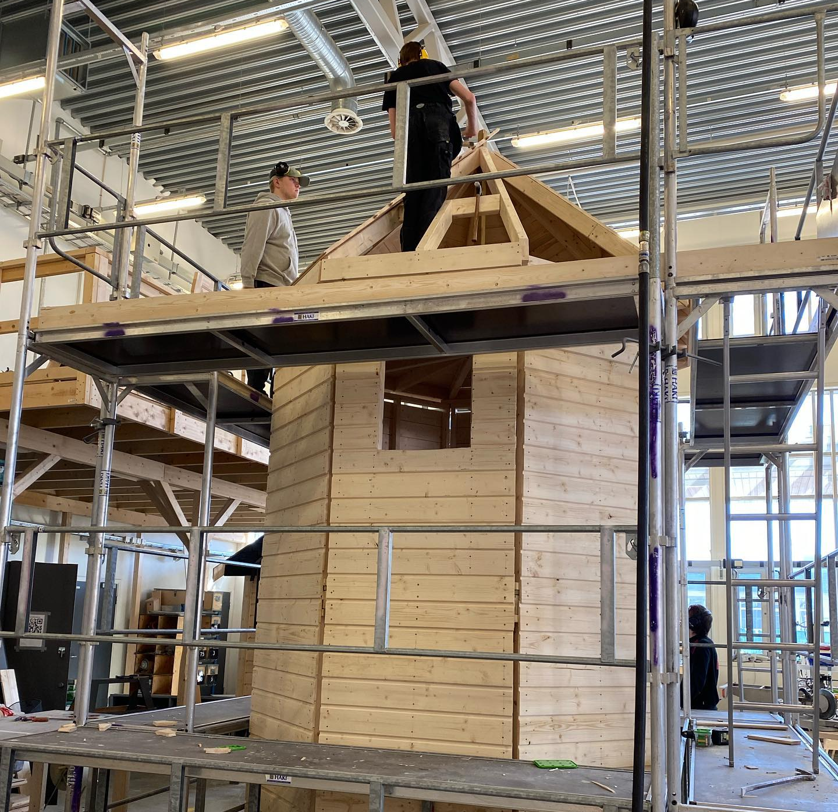
Building and Construction

Slide 8
Hairdresser, flowers, interior- and display design

Slide 9
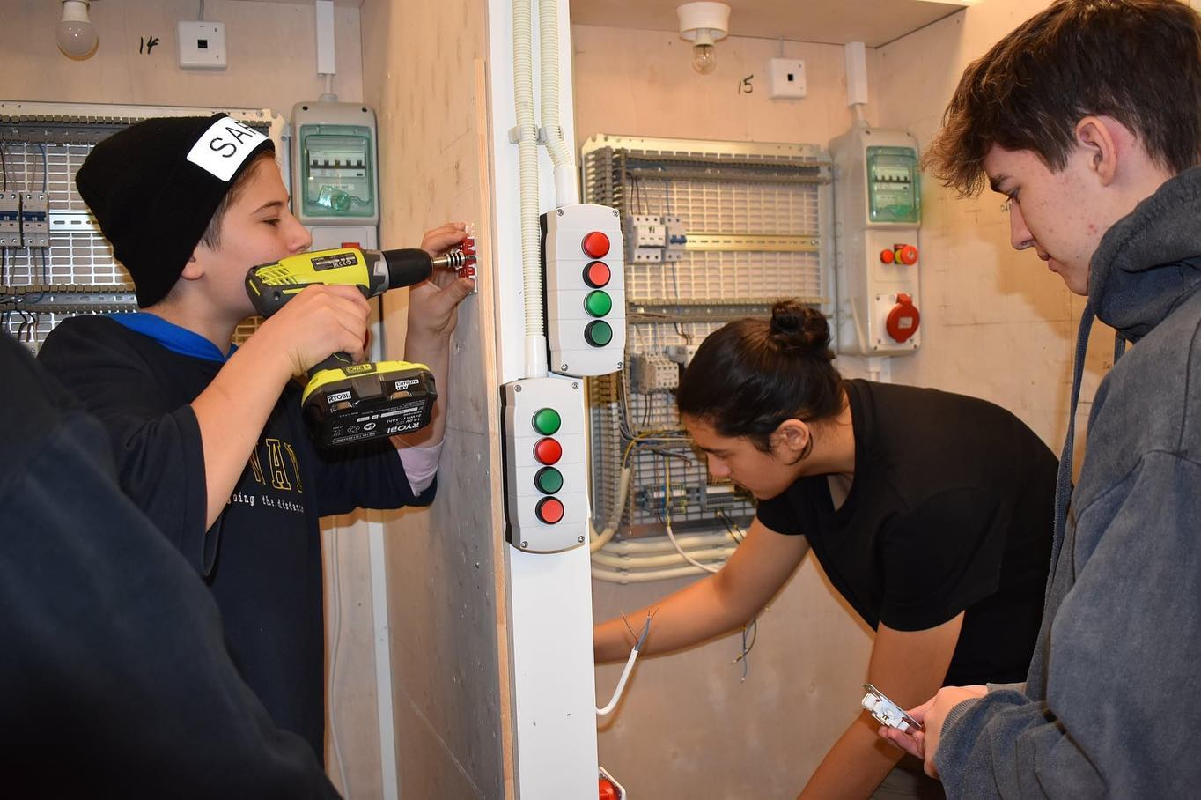
Electricity and Electronics

Slide 10
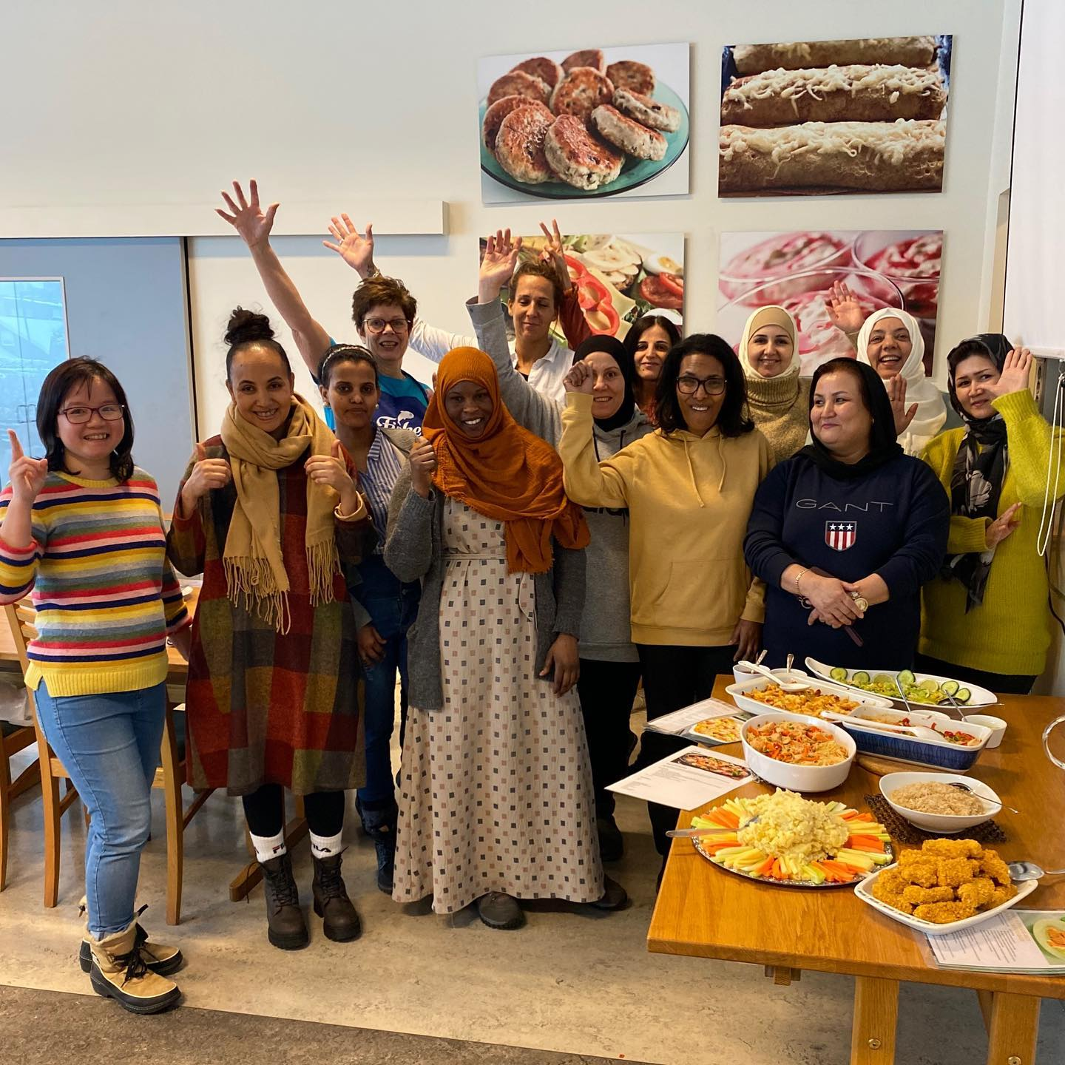
Health and Social Care

Slide 11
Media and Communications
3 year programme
Admission for college and general university

Slide 12
ICT and mediaproduction

Slide 13
Restaurant and Food Processing

Slide 14
Technical and Industrial Production

Slide 15
Supplementary programme for general university and college admission

Slide 16
Typical vocational school
1 out of 4 students low acheevement
1 out of 4 students minority background
60 – 65% boys
20% not in their preferred programme
Notes:
Ulik profil
Flere med kortere botid
Tidligere skolebakgrunn
Vedtak om særskilt norskopplæring

Slide 17
Main model for vocational training:
2+2

Slide 19
Students in a 24-our perspective
Nav-veiledere
Skolehelse-tjenesten
Minoritets-rådgiver
Spes.ped/ elevveiledere
Klar-ferdigRO
PPOT
Rådgivere
Eleven
Notes:
Dette er håndplukkede folk! Rådgivere i kap. 5.

Slide 20
VET-challenges i Norway
Drop-out
Sosial issues
Absence of class
Lack of apprentices/ apprenticeships

Slide 21
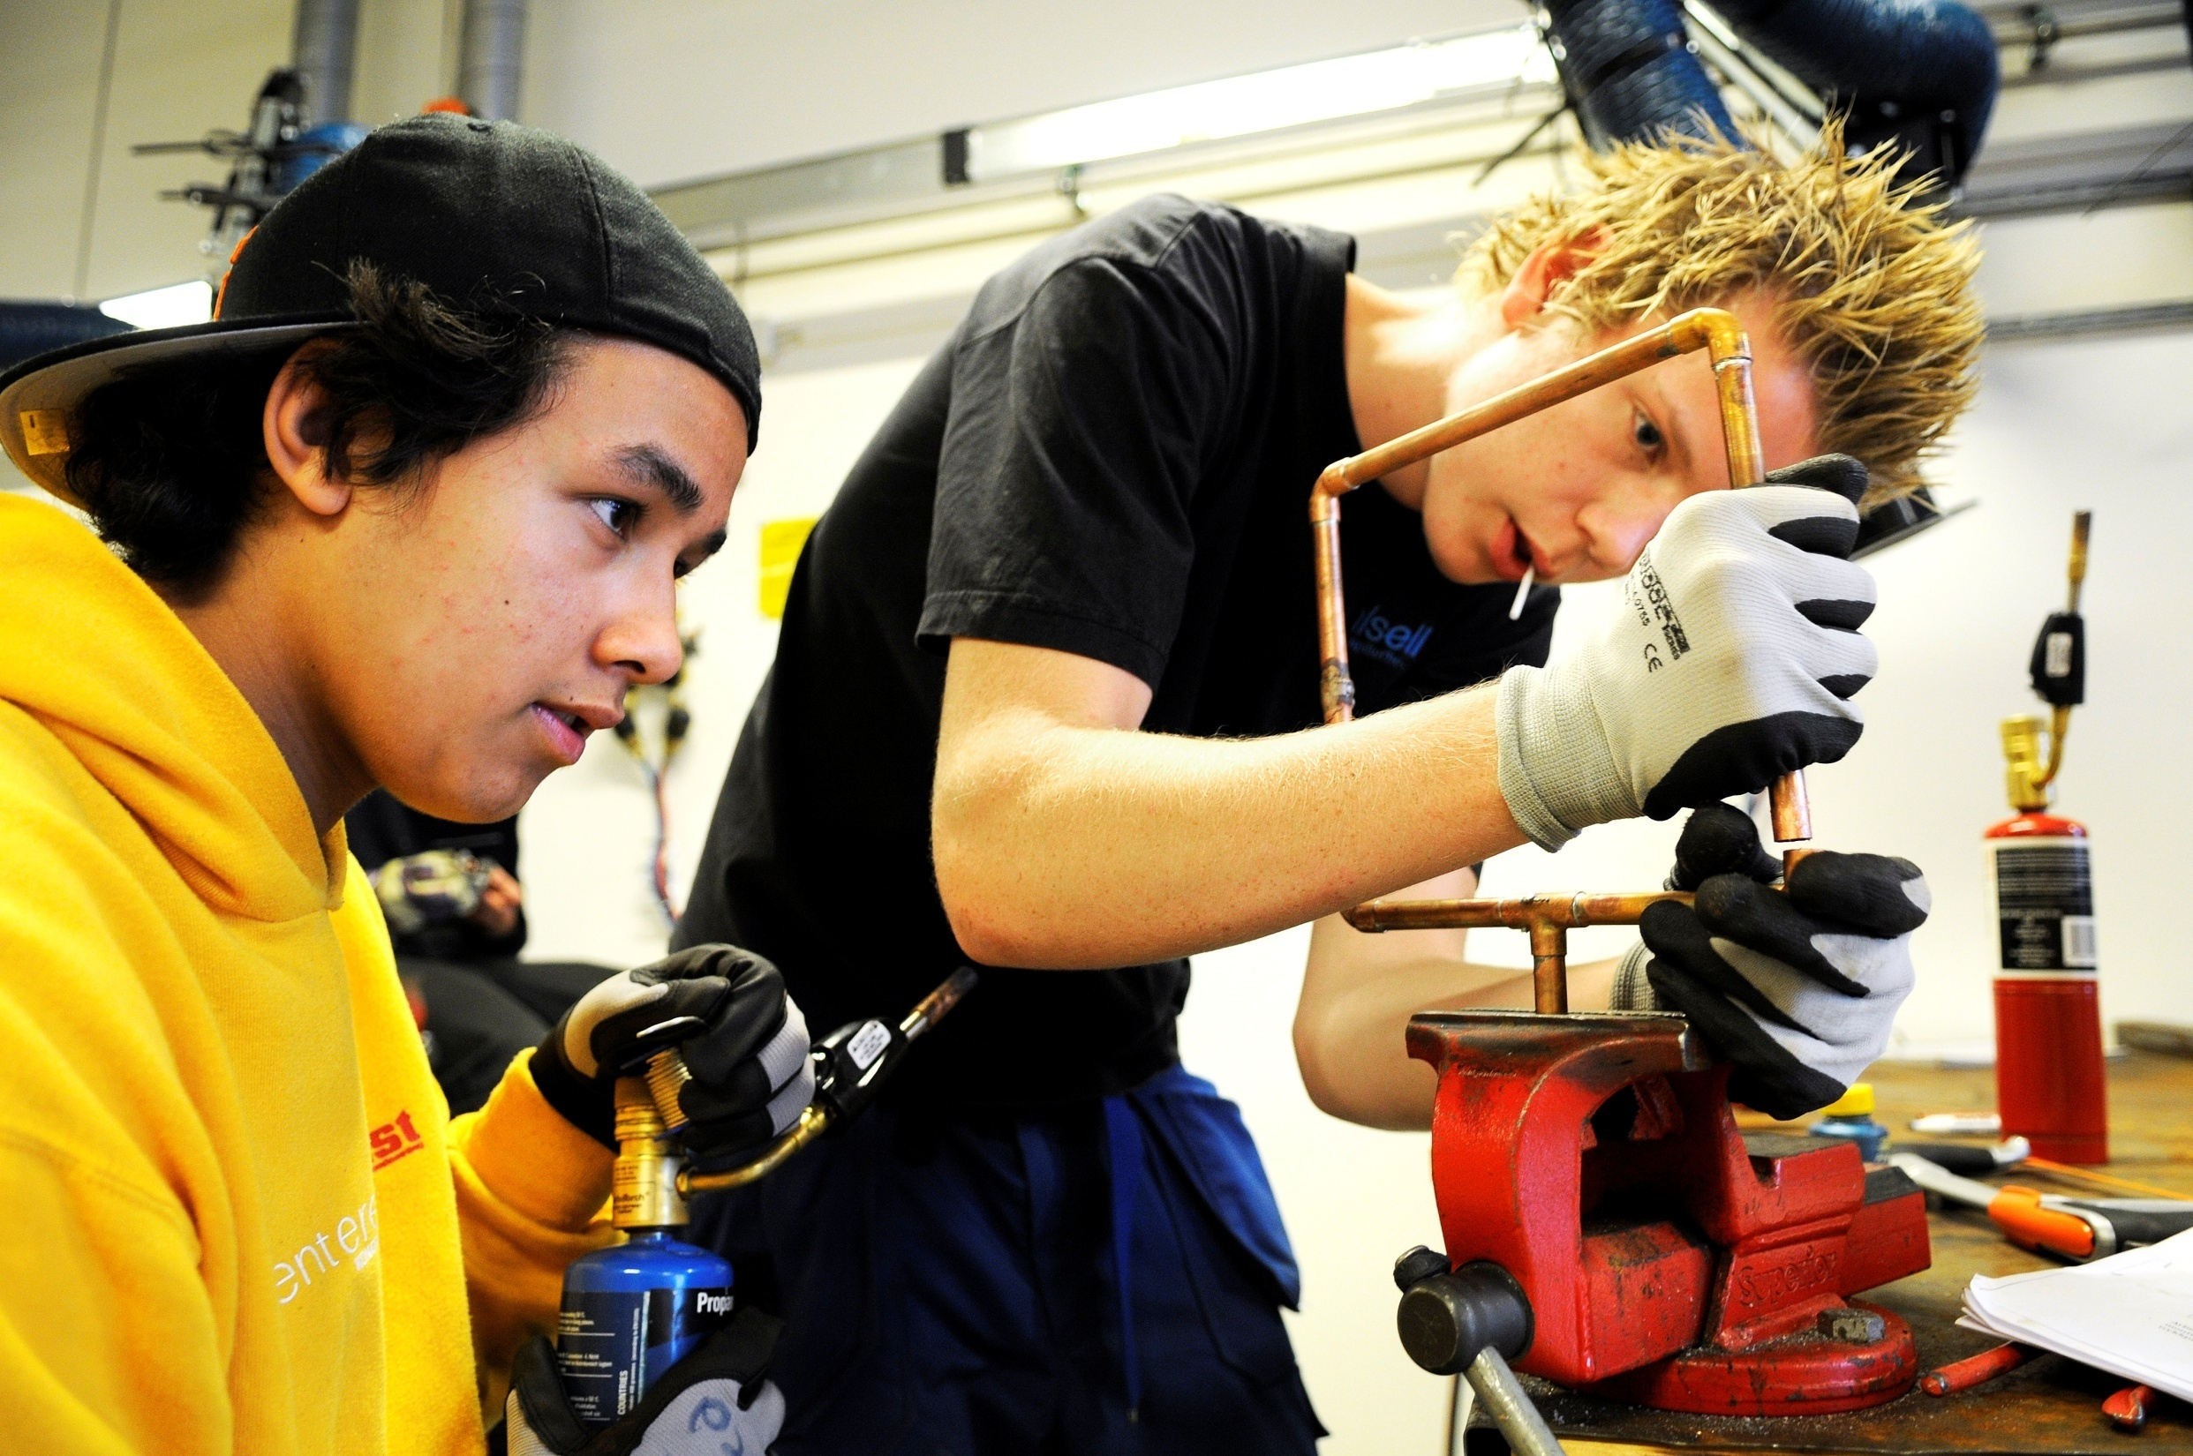

Slide 22
Proud of what we create, proud of who we are
Notes:
We are in the process of establishing an online store, Stolt, where we sell student work - goods and services. Our products are local and unique, and are
made by local youth and adults. With the store, we want to make the vocational subjects even more visible. In norwegian our slogun is «Stolt av det vi skaper, stolt av hvem vi er.» In english: «Proud of what we create, proud of who we are».
We want to give you a little gift from us with our new logo «Stolt». So when you´re back in Iceland and Slovenia, shopping groceries for dinner, you can send us a thought.

Slide 23
The work goes on
Still developing a school culture
Continiously measuring ourselves
Notes:
En verdiforankret revolusjon
Pedagogisk plattform: 2005 – 2007
«Alt» av skoleutviklingsprosjekter
Hva virker?

