Slide 1
Substaning academic learning in rural areas in Iceland
Auðbjörg Björnsdóttir, PhD
Stefán Guðnason, MSc

Slide 2
What is the official strategy of the Icelandic government in regards to academic online learning?
Notes:
What is the official strategy of the Icelandic government in regards to academic online learning?
When asked the minister of education responded with facts on what each university offers in regards to online/blended learning. In fact there is no official policy from the icelandic government in regards to online learning end development on that subject. How ever each University has autonomy in regards to their own policy and strategy. So each University can decide on that them selfs. For example, University of Iceland, the biggest and oldest university in Iceland has no intention to offer their courses online. They did that grudgingly during Covid but as soon as the restrictions lifted they went back to on site teaching.
The University of Akureyri has how ever adapted a full on policy in online teaching. And now each and every course is offered in blended learning/flexible. That means that our students do not have to move from their hometown to Reykjavik or Akureyri to get their degree.
Fifteen to twenty years ago you had to leave your hometown to get further education, resulting in only one out of three returning back after university. Meaning that the rural places were loosing people every year.
So by moving to blended learning the University of Akureyri has helped sustained small rural areas by offering their inhabitants a choice they would otherwise not have.

Slide 3
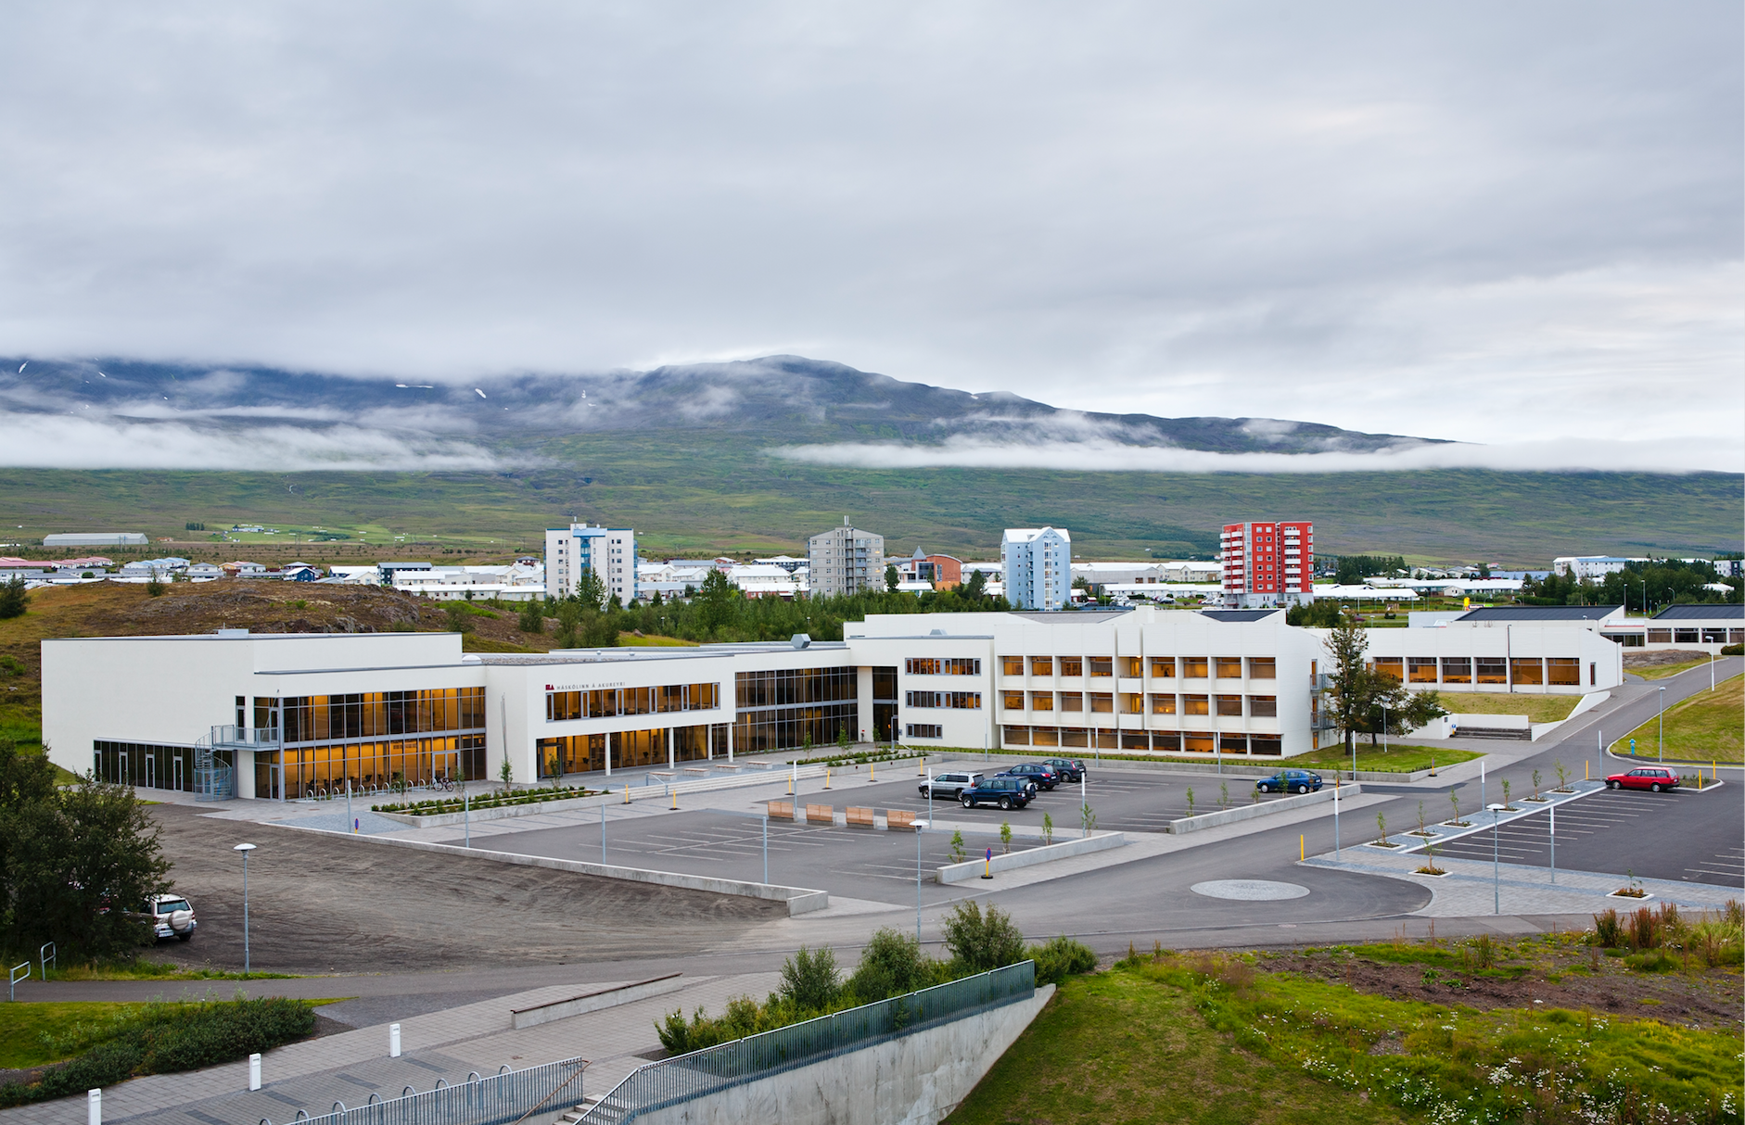
UNAK
A leading university in flexible learning in Iceland:
meets the needs of its students e.g. by introducing more flexibility in its studies
students come from all parts of the country to enjoy the flexible study environment the university offers
The University has played a key role in providing university education, research, development and innovation in rural areas in Iceland
Notes:
By presenting an opportunity for many students to pursue their studies, regardless of their location
UNAK is important for sustainability in rural areas, our research has shown that students are more likely to live in a rural area 5 years after graduation if they were distance students compare to students that moved to the capital to study.
Student body changing, enrollment is peaking ​
Our research has shown that students in distance learning tend to stay in the rural areas, compare to the on site student

Slide 4
History of distance/flexible learning at UNAK
Moving now to more flexible learning
Offered officially since fall 1998 (Nursing)- video conferencing
Other degree programs followed
Increase in enrollment
From 2001, distance learners have been 30-40% of enrolled students at UNAK
Since fall 2016, all undergraduate degrees offered in flexible learning
Fall 2018, 70% of students enrolled as distance learners
The Centre of Teaching and Learning established 2015
Collaboration of IT and teaching specialist
Notes:
With growing numbers of distance learners, and the universities more unique role as the distance/flexible learning university there has been more support with teachers development specifically in terms of how to accommodate the increasing number of distance students
The main objective of the centre of teaching and leanring is to provide professional assistance to faculty members at the University of Akureyri in all aspects of teaching, both consultation and development. We offer specialized consulting in a wide range of areas to help teachers evolve their teaching methods with an emphasis on information technology and pedagogy. In charge of equipment in classrooms and staff work stations.
University of Akureyri (UNAK)
Established 1987
Located in the northern part
of Iceland
~2600 Students
UNAK is a leading university in the field flexible learning in Iceland:
Offered officially since fall 1998 (Nursing)- video conferencing
Other degree programs followed
Increase in enrollment
From 2001, distance learners have been 30-40% of enrolled students at UNAK
Since fall 2016, all undergraduate degrees offered in flexible learning
Fall 2018, 70% of students enrolled as distance learners

Slide 5
Learning centeres in Iceland
Notes:
Learning centers around iceland, students can take exams and have access to learning spaces if the need

Slide 6
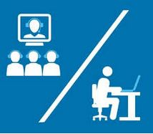
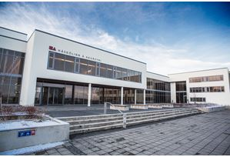
Evolving learning models at UNAK
~2600 Students
Different models used- evolving since 1998 --start of distance learning
Three main delivery modes have been used
Asynchronous (different or same-time,different-place)
Synchronous (Same-time, different-place)
Facing out–
+ Synchronous
Mandatory study sessions on campus –
Notes:
University of Akureyri (UNAK)
Established 1987
Located in the northern part
of Iceland
~2600 Students
UNAK is a leading university in the field flexible learning in Iceland:
meets the needs of its students e.g. by introducing more flexibility in its studies
students come from all parts of the country to enjoy the flexible study environment the university offers
The University has played a key role in providing university education, research, development and innovation in rural areas in Iceland
Delivery of the Synchronous Model
Eight learning centers with several outposts from each center
Independent non-profit organizations
Access to video conferencing, facilities for computers and project work, exam administration
Offered officially since fall 1998 (Nursing)- video conferencing
Other degree programs followed
Increase in enrollment
From 2001, distance learners have been 30-40% of enrolled students at UNAK
Since fall 2016, all undergraduate degrees offered in flexible learning
Fall 2018, 70% of students enrolled as distance learners

Slide 7
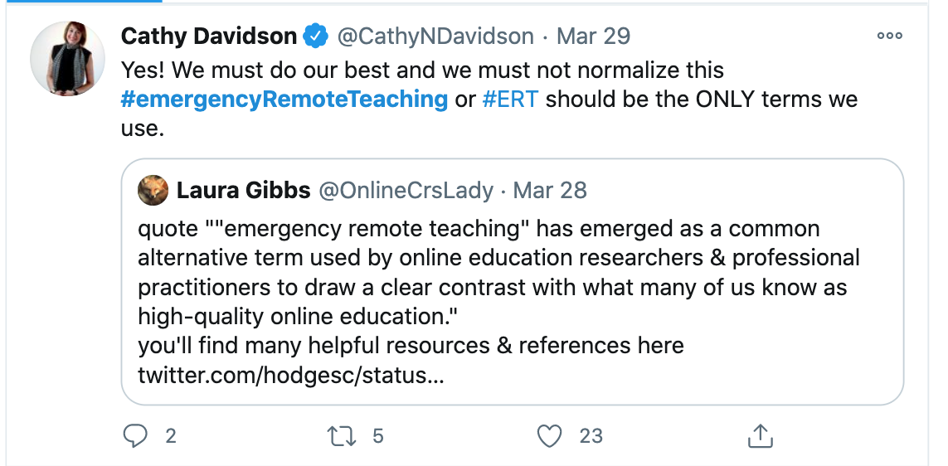
Covid19
What now post-covid!
Emergency remote teaching and learning (ERTL) — aka pandemic pedagogy
Notes:
Lets back up a little and review what happened with covid, when schools suddenly had to go online in as few as 46 hours . Covid19 brough about what is called emergency remote teaching and learning (ERTL) — Aka pandemic pedagogy. This type of teaching and learning is not the same as well-planned and designed online education, because that takes time. This is important because we want to be sure that we are in fact talking about the same thing. Also, conclusions might be drawn from our experience during the Covid that reenforce the the myth that online education is not as good as face to face. The simple comparison of online education to f2f is to simple, because of the variability with in each category. So, just to make sure in many cases what we saw during Covid times was a well executed emergency remote teaching and learning.

Slide 8
Thank you

