Slide 1
Welcome - BlendVET
Tertiary Vocational College - EQF level 5
Principal: Eirik Hågensen

Slide 2
Higher vocational college (FAGSKOLE)
UH - university 3 – 5 år (Ph.d.)
higher professional degree *
Tertiary
UH - 2. år university (Master)
UH - 1. år university
UH - 3. år college (Bachelor)
HYU – 2nd. year Vocational college*
6 years specialization in the same subject area
UH - 2. år college
HYU – 1st Vocational college*
UH - 1. år college
Apprentice – 4th. year VET – Skilled Worker
Secondary
VGS – 3rd. year study preparation
Apprentice – 3rd. year VET – Skilled Worker
VGS – 2nd. year study preparation
VGS – 2nd. year VET
VGS – 1st. year study preparation
VGS – 1st. year VET
Primary School 10 år
Primary
* 60-90 credits. -> (professional degree)
* > 120 credits. -> (higher professional degree)

Slide 3
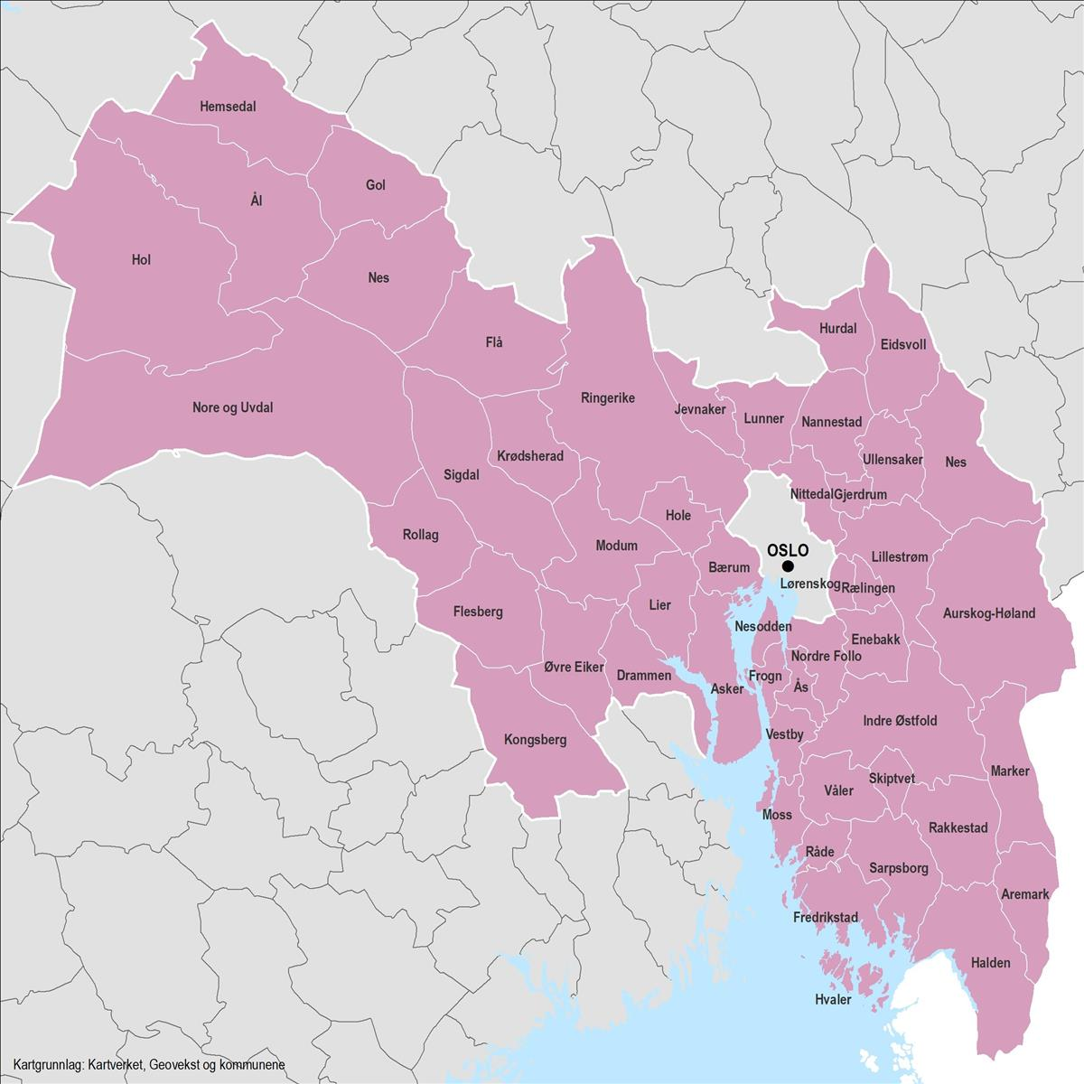
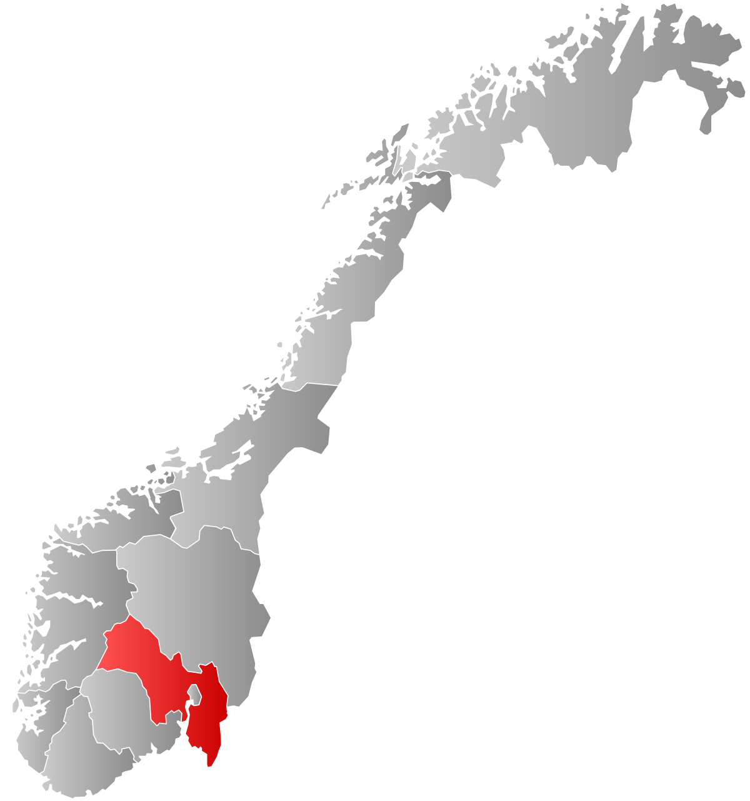
FiV
FiV Øst:
Fredrikstad
Indre Østfold (Askim)
Strømmen vgs.
Bjørkelangen vgs.
FiV Vest:
Kongsberg
Geilo
Rud vgs.
Vestby vgs.
Approx 170 employees
24 593 km²
1 227 305 Inhabitants

Slide 4
Our activities
Electrical Engineering
Computer support and maintenance
Building, construction, BIM, CEE, MOM
Fagskolen i Viken
Healthcare, childhood and youth development
Management
Tourism and resort development
Technology, production and product development

Slide 5
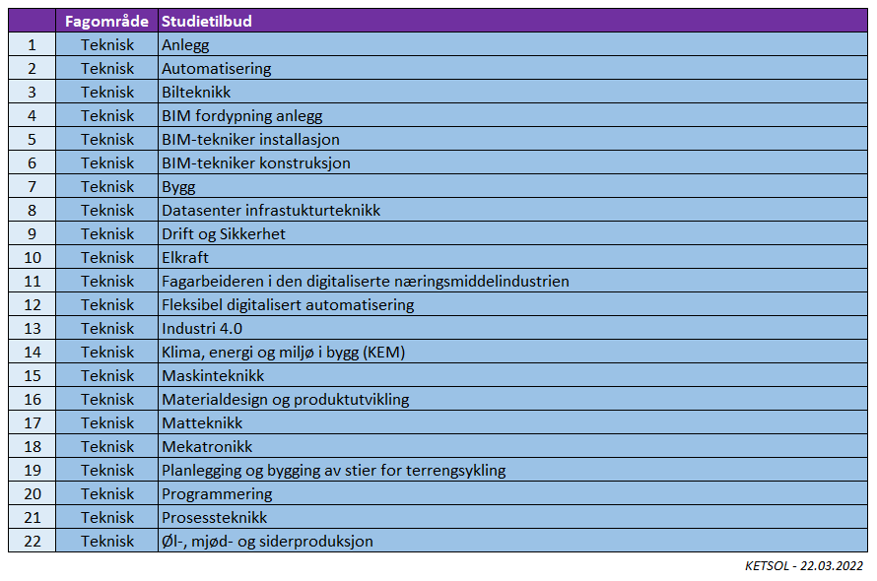
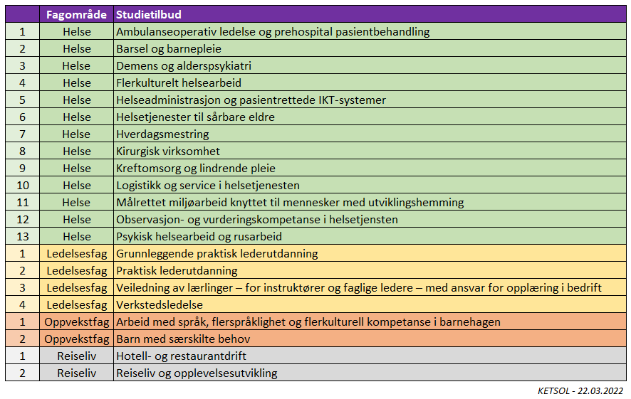
Study offers

Slide 6
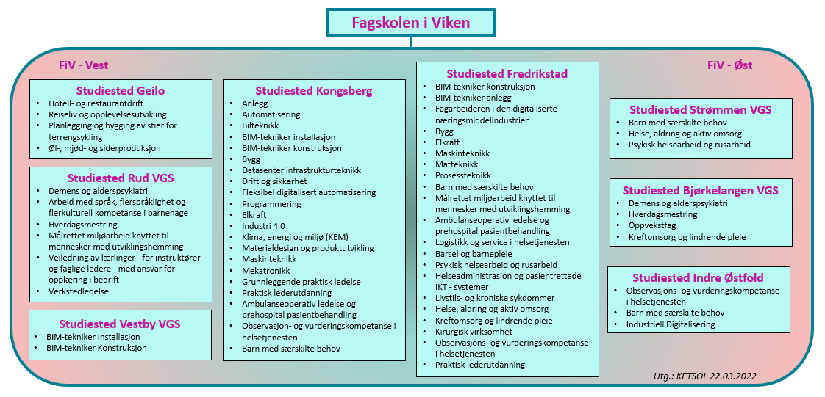

Slide 7
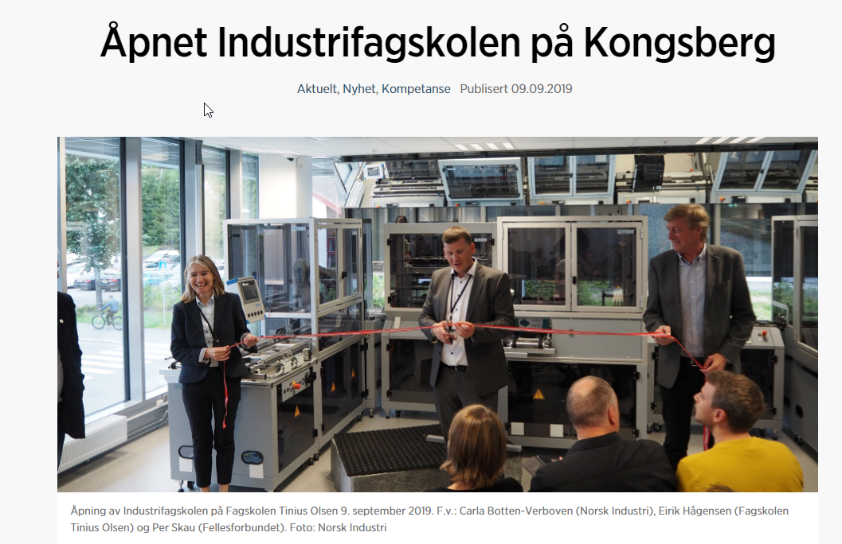
Continuing education – Lifelong learning
Programs:
Facilities and construction
Hair dresser and barber
Management
Health
Hotel and restaurant
Industry
Food production
Oil and gas
Tourism and hospitality

Slide 8
Strategi – Objective - Visions
Vision:
Fagskolen i Viken løser Norges fremtidige behov for høyere yrkesfaglige utdanning
3 Main strategic directions:
Lifelong learning
National position
Organizational strategy

Slide 9
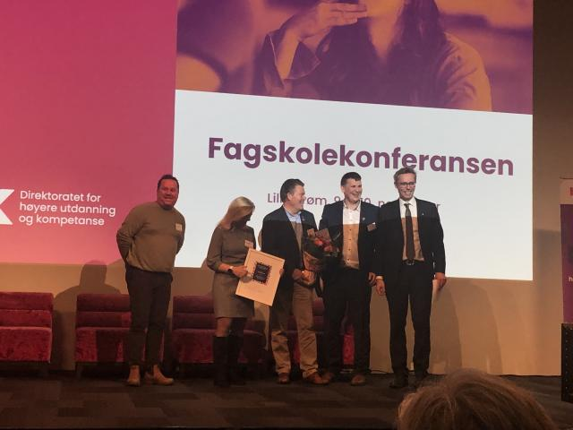
Awarded the quality price for vocational education - tertiary level in 2021

Slide 10
Internasjonalisering

Slide 11
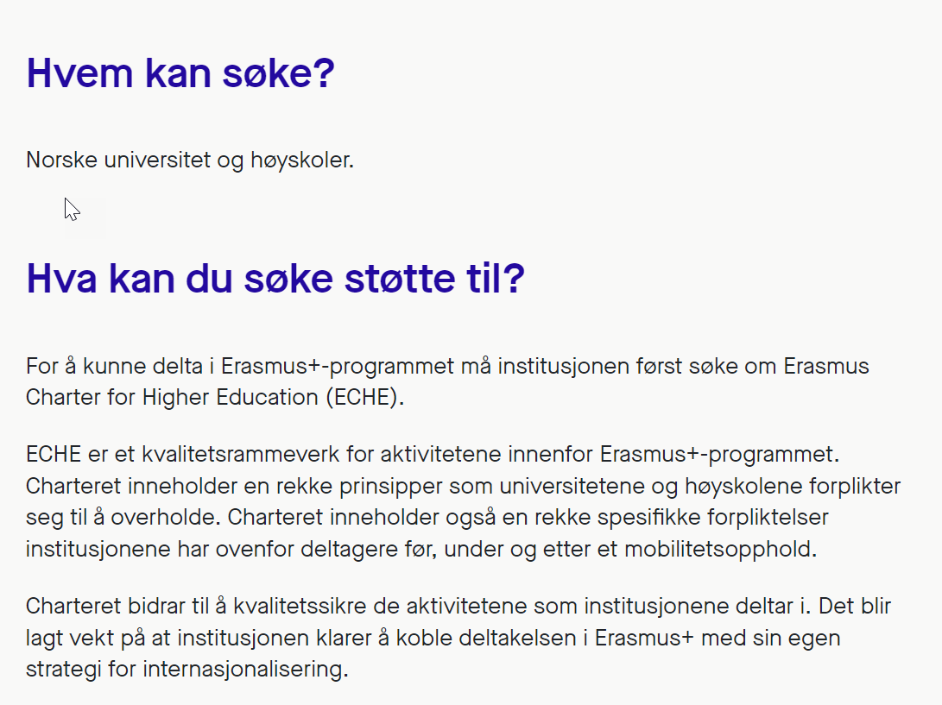
Erasmus Charter for Higher Education (ECHE)

Slide 12
Erasmus+ Charter
Fagskolen i Viken har blitt godkjent for
KA120-VET Mobility Charter

Slide 13
ERASMUS+ KA2 projects
DIRTT (koordinator): Utvikling av ny utdanning for byggere av stier for terrengsykling
Partnere: OFT (NO), IMBA EU (NL), DGI (DK), Bikeplan (CH), Agueda (PT), Edinburgh Napier University (UK), SCU (UK)
TEFFIC: Utvikling av pedagogisk rammeverk for Industri 4.0
Partnere: UCN (DK, koordinator), Universitetet i Ålborg (DK), TalTech (EE), Europauniversitet Flensburg (DE), Thomas Moore Universitetet (BE) [avsluttet]

Slide 14
ERASMUS+ KA2 projects
DIGIDEMO: Utvikling av laboratoriemodeller (demonstratorer) for digitaliserte (IoT) produkter
Partnere: UCN (DK, koordinator), ESTA (ASSOCIATION POUR LA GESTION DE L'ECOLE SUPERIEURE DES TECHNOLOGIES ET DES AFFAIRES, FR), FHV (FACHHOCHSCHULE VORARLBERG GMBH, AU), UEMR (Universitatea "Eftimie Murgu" din Resita, RO),
NETKOM 2.0: Utvikling av «best practice» læringsopplegg innen Industri 4.0
Partnere: EUROPA-UNIVERSITAT FLENSBURG (DE, koordinator), Regionales Bildungszentrum Eckener-Schule AöR (DE), VILNIAUS TECHNOLOGIJU IR DIZAINO KOLEGIJA (LT), HTBLuVA St. Poelten (AU), ATEC - Associação de Formação para a Industria (PT), Gewerbliche Schulen des Lahn-Dill-Kreises (DE)

