Slide 1
BlendVET How I stumbled into “blended learning” (teaching)
Flipped classroom
-and how I coped
Sigmund Sundfør
Teams
Plan…….??

Slide 2
Agenda and goal – where should I start?
Agenda
«Flipped classroom» - my implementation
Where do I (the student) find the material?
Student tasks – and follow up
Sharing resources / «Repository»
Goal
That you get some understanding of how I organise and do the digitally based teaching
That you give me feedback with new ideas and possible improvements

Slide 3
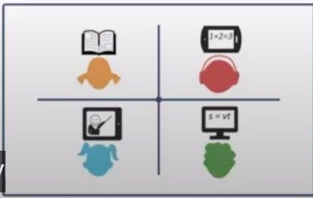
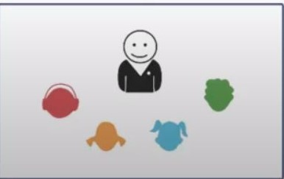
Flipped classroom (a new concept for me)
The idea – as I understand it
«..a type of blended learning where students are introduced to content at home and practice working through it at school» (TeachThought)
The students studies the lesson at their own pace.
The time with the teacher is at the students’ disposal
Further explanations
Practising what they have learned

Slide 4
Flipped classroom – how I do it
The week before we meet up in the classroom, I publish using Teams:
Video where I go through the lesson
Copy of the presentation used in the video
A set of problems to be solved related to the lesson. Some simple ones so that they get confidence in practising what they have learned in this lesson; some more challenging tasks.
Message via Teams to the students on what next lesson is
When we meet (via Zoom) – I ask them what they want to do
In most cases, they want to spend the time working through the set of problems.
They want recording of the session. Recording and copy of notes (pdf) are copied to Teams

Slide 5
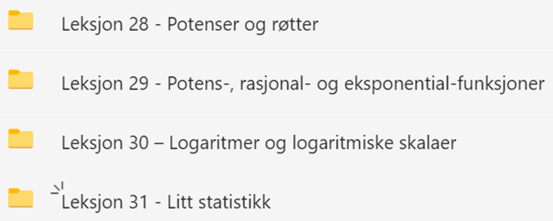
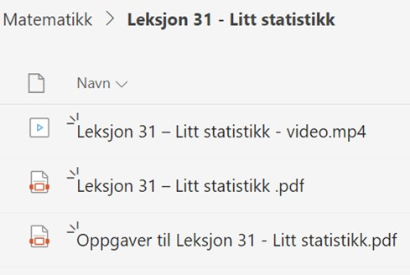
Where do you find the material?
The plan for the term: – one lesson per week
The structure on Teams mirrors this
Under <team> / Files you will find a folder for each lesson
Here is a typical content of such a folder published a week ahead of the lesson
Video where I go through the lesson
Copy of the presentation used in the video
The set of problems to be solved (maths and physics)
Recording and notes are copied to the same folder after the lesson

Slide 6
Web – tests, for each section /chapter
Student tasks / «web-tests» (obligatory)
A set of tests had been developed using an earlier tool, «ItsLearning» - now implemented using Teams/Forms. Used for practising and as a repetition.
Aim is to ensure that they try practising what they have learned.
We are using automatic scoring, but have no minimum score – only that all students must have done the tests

Slide 7
Follow-up of the students
Weekly messages on last lesson and the one for the following week.
Contact with individual students via Teams/Chat – normally initiated by the student.
Excel sheet, completed / not completed tests.
«Hurry-up» or «concerned» Teams/chat to those lagging behind
-at irregular interval – «when time allows»
Students who have not completed all web-tests fail

Slide 8
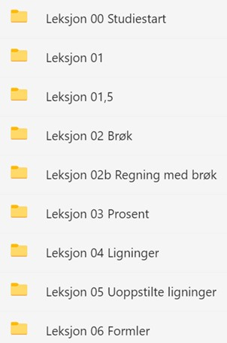
Sharing resources/ «Repository»
What I create, I ought to share
Currently - no good solution.
Temporary «Repository»
One team dedicated to act as shared resource: «FTO-Realfag – FSTIN»

Slide 9
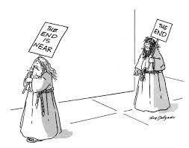
Was that all? yes

